Slide 1


TEAM: THE HONOURED ONES
Rahul Jadvani
Sachin Baluragi
Sai Jadhav
Prathiksha
TRACK: DEFI + FINANCIAL INCLUSION AGENTS

Slide 2

THE STORY THAT STARTED IT ALL
Meet Arjun — Crypto-Native, Credit-Invisible
Self-taught blockchain dev, 18+ months in DeFi
Gets paid in crypto, active onchain
Needs ₹2,000 for work-related spending
Doesn’t have a credit card or formal credit history
Despite being financially active, Arjun is invisible to both banks and Web3 lending.
Traditional Credit Leaves Arjun Behind
🏦 Credit Card Rejected — no CIBIL, no salary slips
🧊 DeFi Lending Overcollateralized — needs ₹3,000 to borrow ₹2,000
📲 BNPL Apps Centralized & off-chain — doesn’t accept crypto wallet history
👪 Family/Friends Don’t recognize crypto as real value

Slide 3


THE STORY THAT STARTED IT ALL
CLen = India’s Web3 Credit Card Layer
ZKP-AADHAAR VERIFICATION – PROVES IDENTITY, KEEPS PRIVACY
TIERED NFT CREDIT VOUCHERS – ₹1K DEPOSIT → ₹2K CREDIT
AI WALLET AGENT – MANAGES EMI, ALERTS, UPGRADES
SBT CREDIT PROFILE – CREDIT HISTORY BUILT ONCHAIN
SPEND NOW, PAY LATER – NO BANKS, NO PAPERWORK, JUST YOUR WALLET
ARJUN REPAYS → UNLOCKS TIER 2 → EARNS CASHBACK → BUILDS REPUTATION

Slide 4
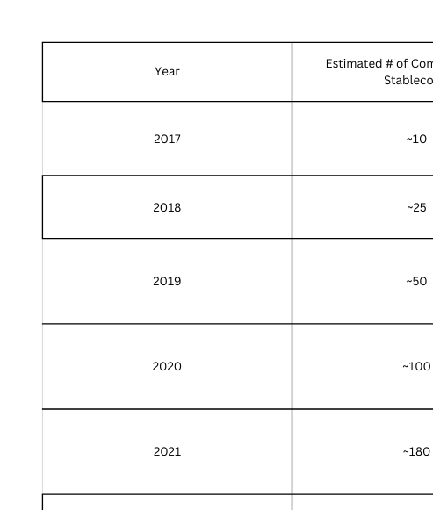
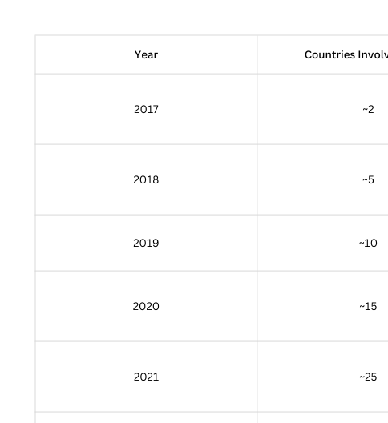
WHY CLEN?

Slide 5
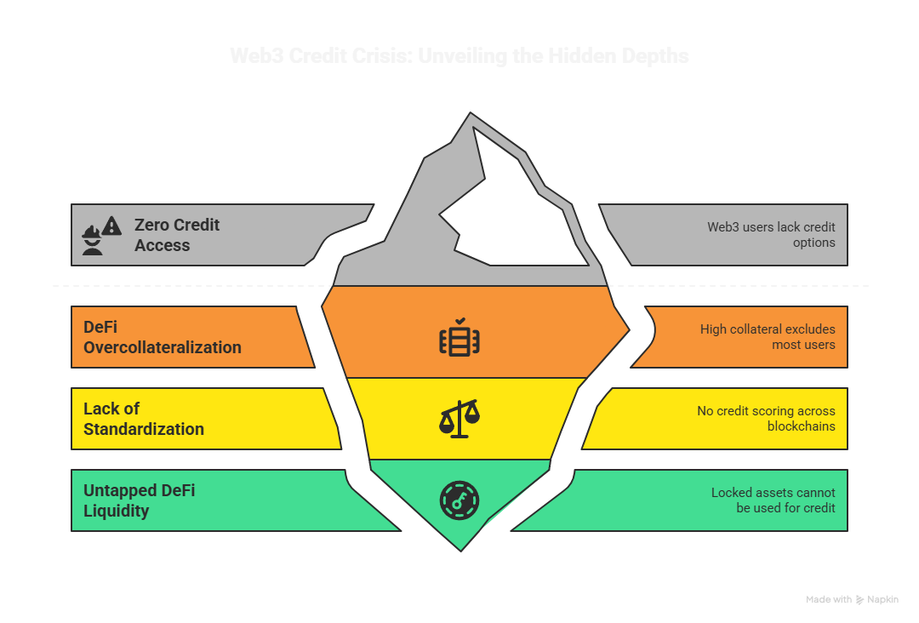
THE GLOBAL CRISIS WE'RE SOLVING
→ The Web3 Credit Trap
1.2B+ users have zero access to credit in Web3
$100B+ locked in DeFi, but users can’t borrow without collateral
95% excluded due to 150–200% overcollateralization
No credit score standard across chains
Identity is fragmented, reputation non-portable

Slide 6
CLEN 3.0 - THE AUTONOMOUS CREDIT PROTOCOL
Vision: A blockchain-native credit infrastructure that transforms Web3 activity into creditworthiness — enabling undercollateralized lending through AI-powered risk assessment.
Core Innovation: Credit Voucher NFTs
Tradeable, upgradeable NFTs that represent verified credit capacity, not locked collateral.
HOW IT WORKS:
AI CREDIT SCORING: ANALYZES WALLET HISTORY, DEFI BEHAVIOR & CROSS-CHAIN REPUTATION
MINT CREDIT VOUCHER NFT: ISSUED WITH TIER & SPENDING LIMIT
SPEND NOW, REPAY LATER: USE CREDIT ON-CHAIN WITH PARTIAL OR NO COLLATERAL
DYNAMIC RISK ENGINE: ADJUSTS TERMS BASED ON REAL-TIME BEHAVIOR
COMMUNITY ATTESTATIONS: BOOST TRUST, UNLOCK HIGHER TIERS

Slide 7
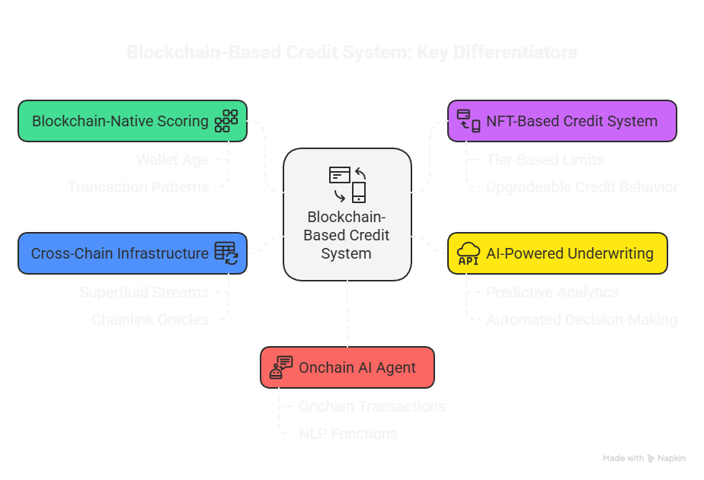
Key Differentiators:

Slide 8
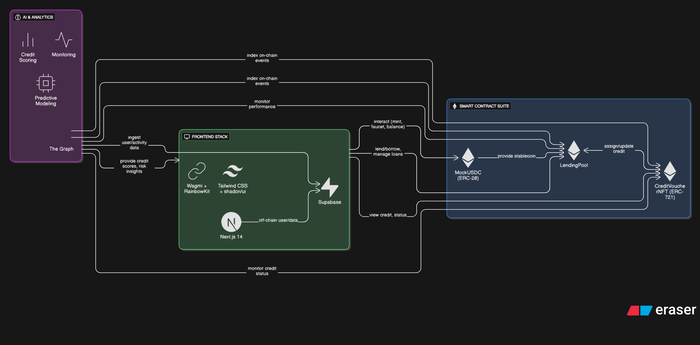
HOW CLEN WORKS - CORE ARCHITECTURE

Slide 9
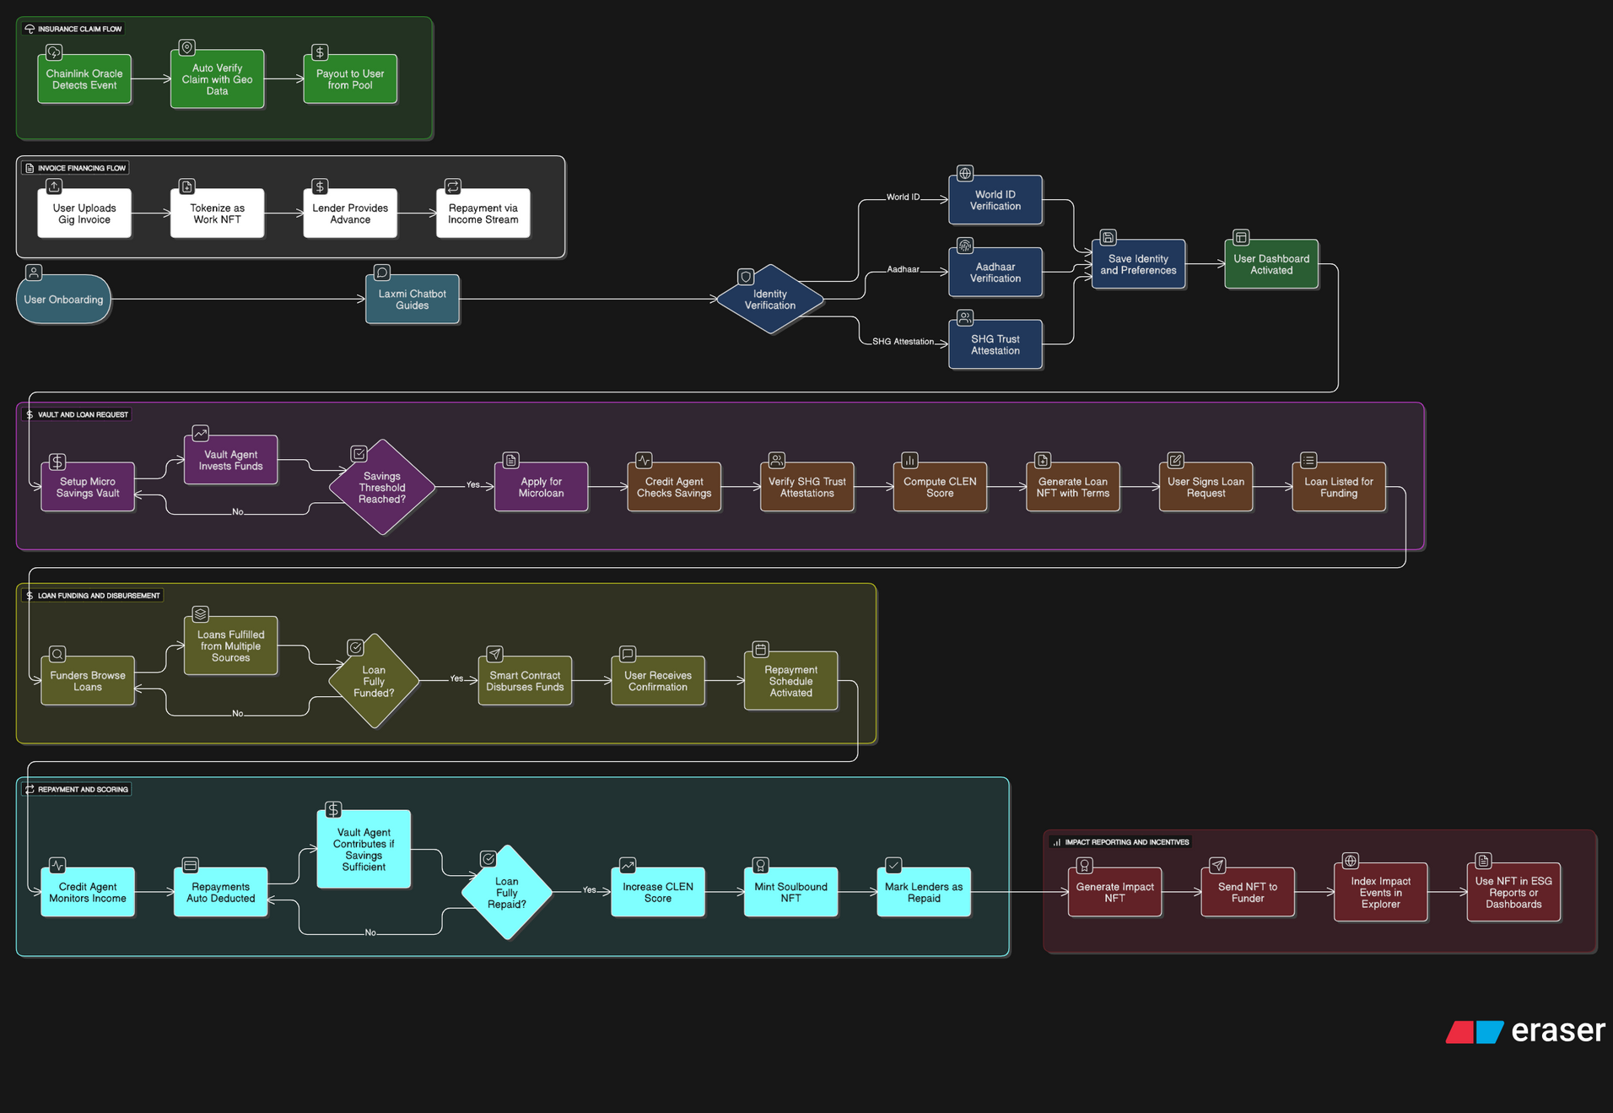
HOW CLEN WORKS

Slide 10
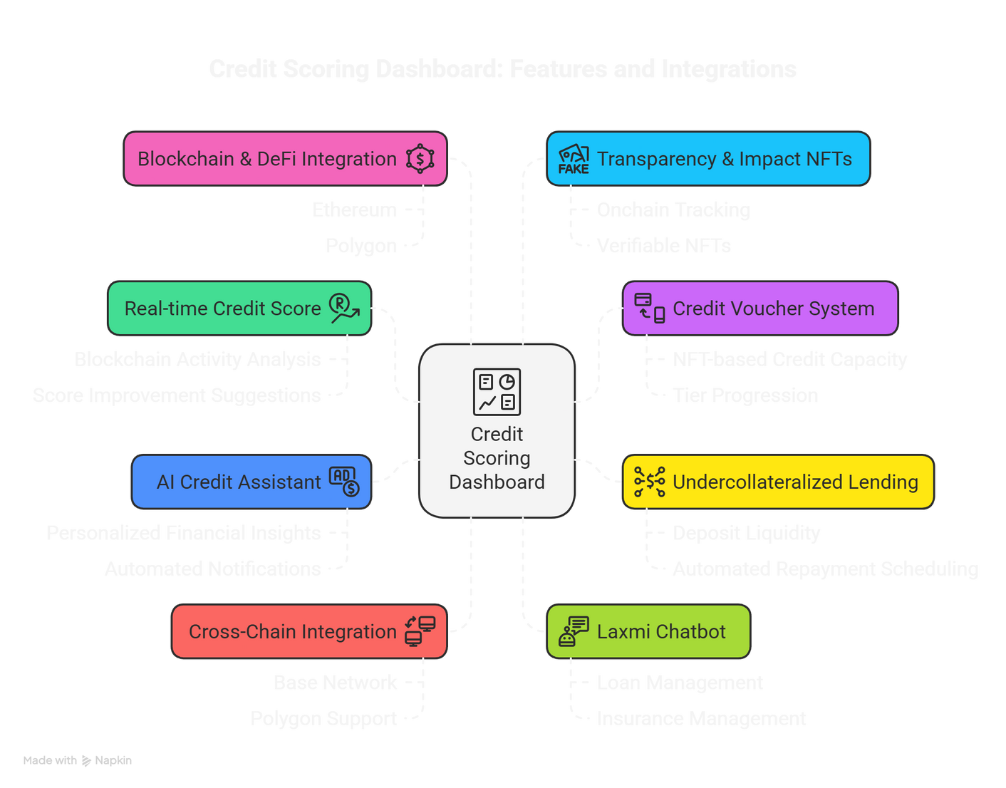
CORE FEATURES
CREDIT SCORING
REAL-TIME SCORE (300–850)
ON-CHAIN BEHAVIOR + AI TIPS
CREDIT VOUCHERS
NFT-BASED CREDIT LIMIT
TIERS: BRONZE → GOLD
AUTO APPROVALS & TRACKING
UNDERCOLLATERALIZED LENDING
BORROW WITHOUT FULL COLLATERAL
EMI & DYNAMIC INTEREST RATES
AI ASSISTANT
SMART INSIGHTS & ALERTS
CREDIT TIPS & EDUCATION
CROSS-CHAIN SUPPORT
BASE + POLYGON
MULTI-WALLET & BRIDGE TRACKING
LAXMI CHATBOT
VOICE-BASED, LOCAL-LANGUAGE GUIDE
ONCHAIN TRANSPARENCY
SUPERFLUID, CHAINLINK, IMPACT NFTS

Slide 11
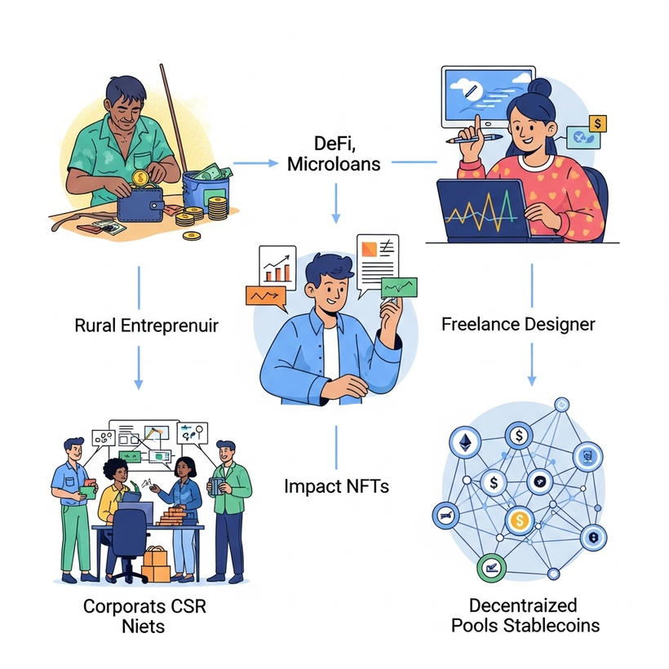
REAL USE CASES ACROSS THE ECOSYSTEM
1.Arjun – DeFi Yield Farmer
Profile: 18 months on-chain, $15K DeFi portfolio
Need: $3K for new farming strategy
CLen Impact: AI flagged low-risk → Silver Voucher
Result: 12% APR, full repayment → Upgraded to Gold
2.Priya – NFT Creator
Profile: Irregular income, strong community presence
Need: $1K for art tools during bear market
CLen Impact: Community attestations boosted eligibility
Result: Bronze Voucher approved despite low on-chain activity
3.Dev DAO – Collective Borrowing
Profile: 50-member dev DAO with on-chain treasury
Need: $25K for hackathon sponsorship
CLen Impact: Members pooled vouchers
Result: Large loan based on collective reputation
4.Sarah – Cross-Chain Trader
Profile: Power user across 5 chains, high volume
Need: Recognized credit for $10K liquidity buffer
CLen Impact: Aggregated multi-chain behavior
Result: Gold Voucher issued at 8% APR

Slide 12
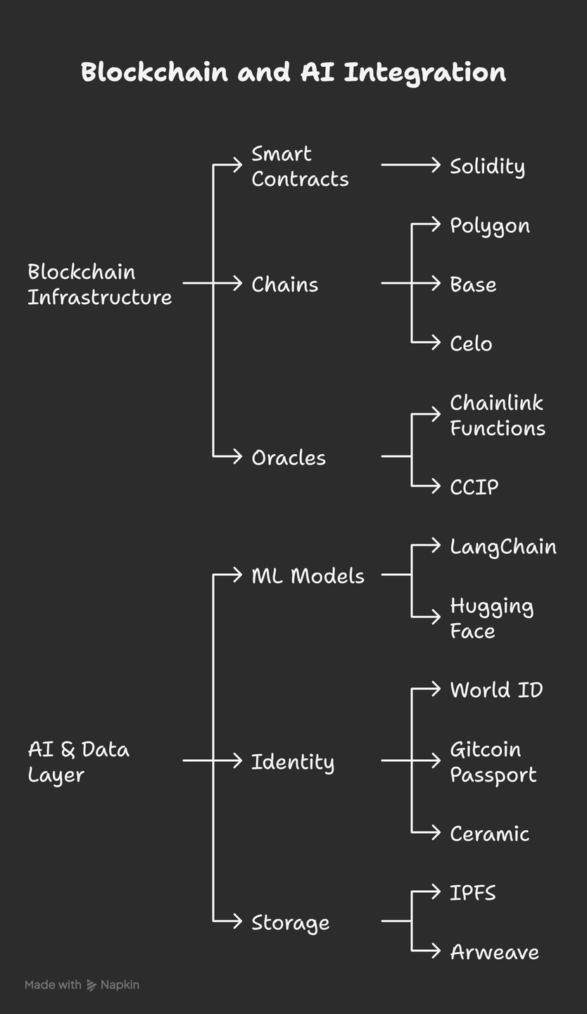
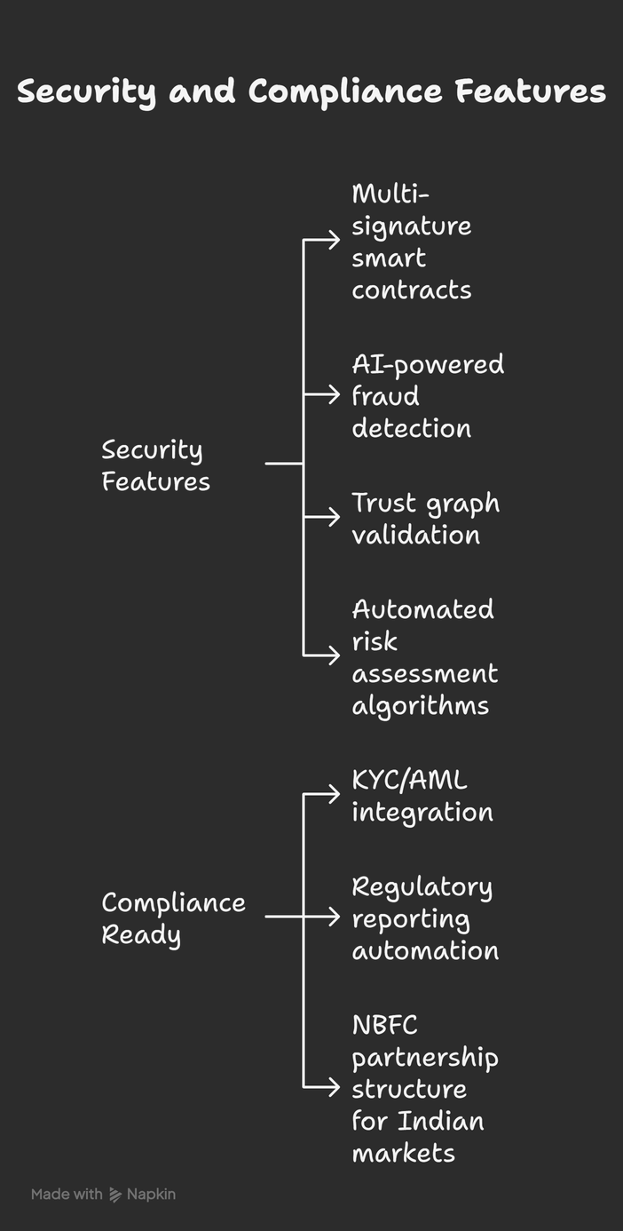

TECHNOLOGY STACK & SECURITY

Slide 13
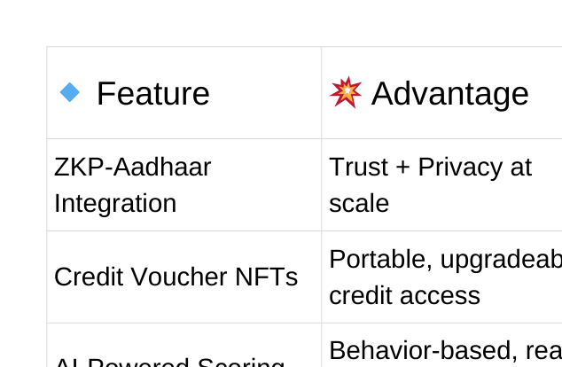
MARKET IMPACT & COMPETITIVE ADVANTAGE
Massive Addressable Market
400M+ underbanked Indians
$100B+ DeFi liquidity locked
Rising demand for on-chain credit alternative
💡 Why We Win
Inclusive by Design: Undercollateralized, identity-based
Scalable: Works across chains, wallets, and users
Compliant & Transparent: Built for long-term adoption

Slide 14
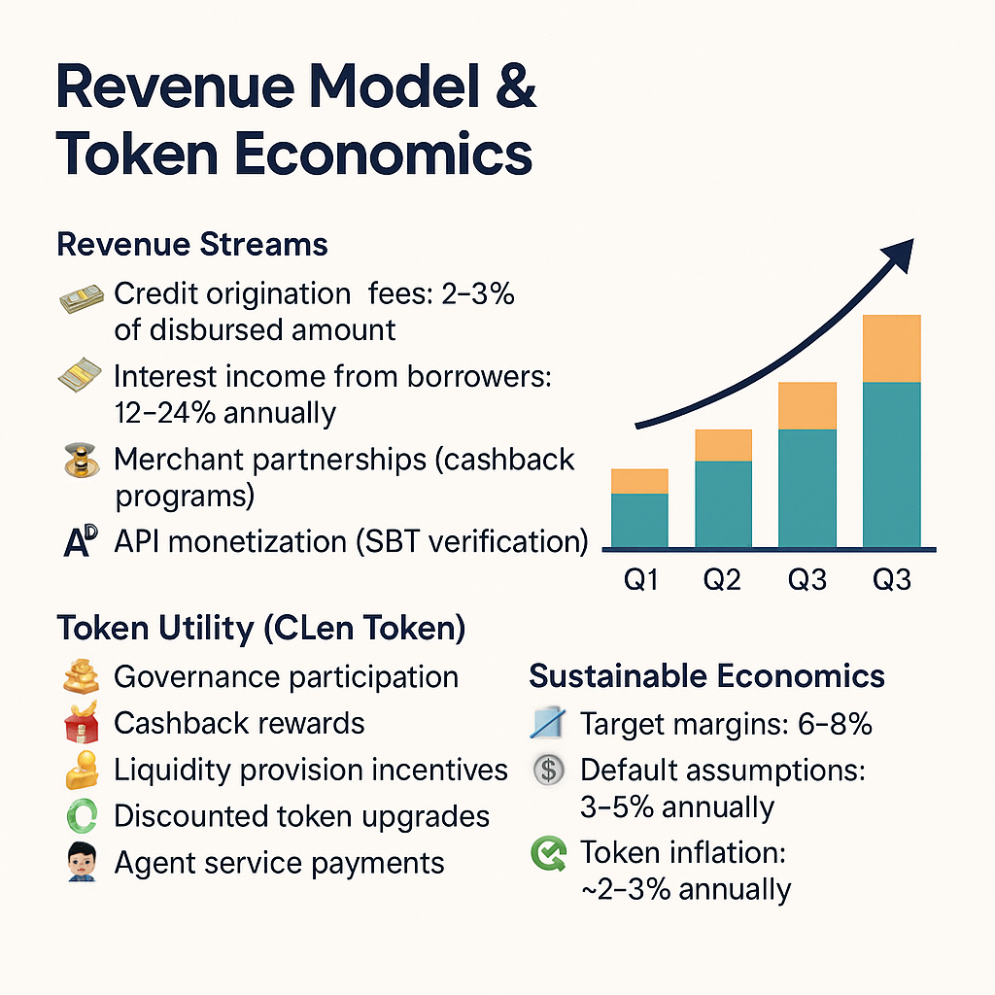
REVENUE MODEL & TOKEN ECONOMICS
Revenue Streams
Credit Origination Fees: 2–3% of voucher-based credit issued
Borrower Interest Income: 12–24% APR, dynamically adjusted
Liquidity Provider Fees: Protocol fee from staked capital yield
SBT API Access (B2B): Verifiable credit scoring for DeFi partners
Merchant Cashback Split: 10% to users, 2% to protocol
Premium AI Agent Services: Pay-per-use or subscription model
CLen Token Utility
Governance: Vote on protocol upgrades & risk models
Staking: LP yield, risk coverage pools
Tier Upgrades: Discounted upgrades for holders
Rewards: Cashback for timely repayments
Agent Services: Unlock premium AI features
Tokenomics Snapshot
Net Interest Margin: 6–8% (after default buffer)
Token Inflation: 2–3% yearly for growth
Default Reserve: 3–5% allocated to Protection Pool
Staking Yield Target: 8–15% APY

Slide 15
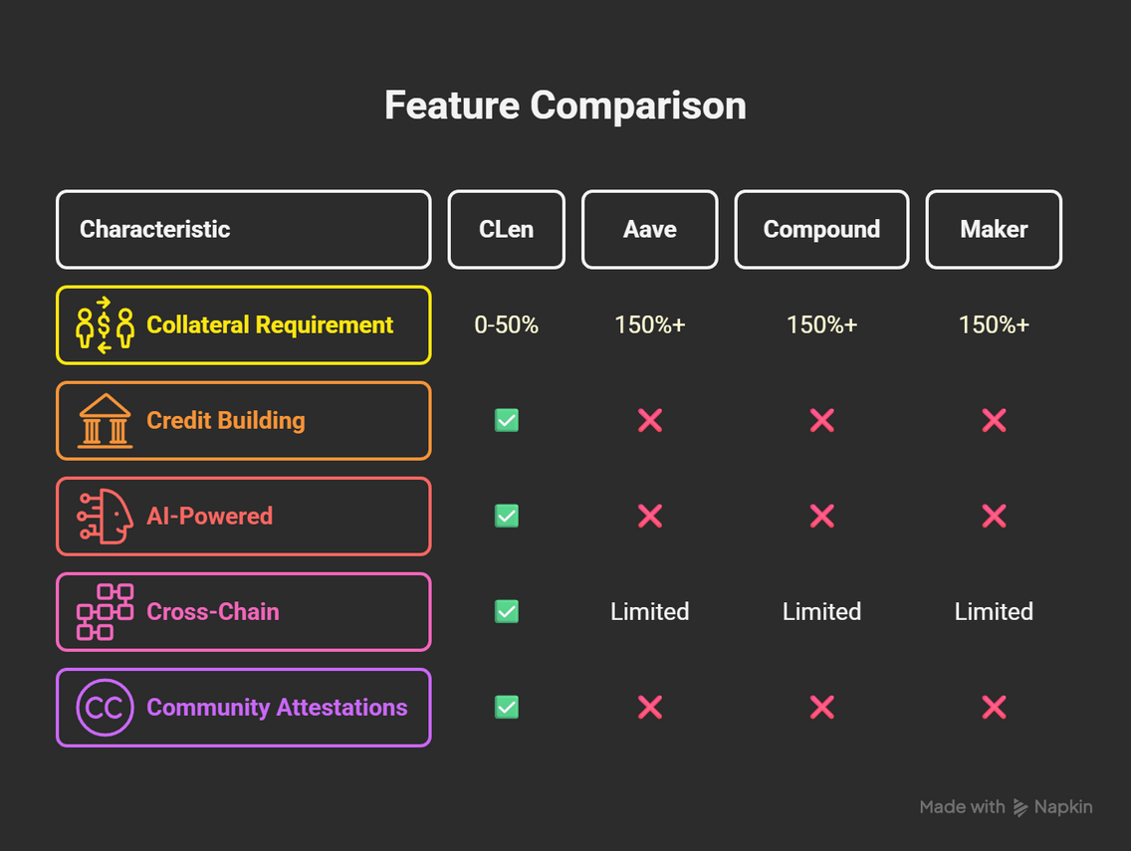
COMPETITIVE ADVANTAGE & MARKET POSITION
Feature | CLen Protocol Advantage
Identity Integration | ZKP-Aadhaar → Real trust with full privacy
Credit Voucher NFTs | Collateral-free, upgradeable, and portable
AI Credit Scoring | Real-time, behavioral, cross-chain
Voice + Agent UX | Laxmi chatbot → Local-language credit access
SBT Reputation Layer | Interoperable trust across protocols
CLEN ISN’T JUST A LENDING PROTOCOL — IT’S THE CREDIT IDENTITY LAYER FOR WEB3 INDIA AND BEYOND.

Slide 16

THANK YOU!

